Slide 1
Learning objectives
Basic Pharmacology of Opioids
Describe the opioids: prototype, morphine vs codeine
Explain the mechanisms of opioid (morphine/fentanyl) action at peripheral tissues, spinal cord and brain
Describe the pharmacological responses associated with the stimulation of μ, δ, κ receptor subtypes by the endogenous opioid agonists (endorphins, dynorphins, enkephalins)
Contrast the differences in pharmacology between morphine and other agonists such as meperidine, fentanyl & methadone.
Discuss the toxicity and treatment of morphine overdose
Compare the full agonist, partial agonists and agonist-antagonists
Name and compare the opioid antagonists (MOR)
Describe the mechanism of action of cannabinoids and their interaction with opioid drugs

Slide 2
Opium is the dried powdered mixture of 20 alkaloids obtained from the unripe seed capsules of the poppy
Opiate refers to any agent derived from opium
Opioid refers to all substances (exogenous or ndogenous) act on opioid receptors or with morphine-like properties
Endogenous opioid peptides: Endorphins, Enkephalins, Dynorphins
The prototypical agent of opioids is morphine: all other opioids are compared to morphine’s activity (a natural opium alkaloid)

Slide 3
GPCR and Analgesic
μ receptor (MOR) – primarily responsible for analgesia, euphoria, respiratory depression and physical dependence
Agonists: Endorphins, enkephalins, morphine, fentanyl, methadone, meperidine, and others
κ receptor (KOR) - responsible for mixed-action agonists and analgesia at the level of the spinal cord, sedation and dysphoria
Agonists: Dynorphins, pentazocine, butorphanol
δ receptor (DOR) - anxiolytic and antidepressant activity
Agonists: Enkephalins, morphine, codeine
Which one of the following opioids produces the strongest analgesic effect?
Which one of the following opioids produces a weaker analgesic effect?

Slide 4
Which of the following is the therapeutic effect of opioids?
A. Analgesia
B. Euphoria
C. Nausea and vomiting
D. Respiratory depression
Which of the following is a type of opioid receptor that has analgesic effect? [Select all that apply]
A. µ receptor or MOR
B. κ receptor or KOR
C. δ receptor (DOR)
D. CB1 receptor
E. GABA-A receptor
Which of the following is an endogenous opioid peptide? [Select all that apply]
A. Endorphins
B. Enkephalins
C. Dynorphins
D. Morphine
Which of the following is paired correctly?
A. Endorphins / analgesic, respiratory depression, euphoria, MOR
B. Enkephalins / analgesic, anxiolytic, MOD
C. Dynorphins / analgesic, sedation, dysphoria, MOK
D. All of the above

Slide 5
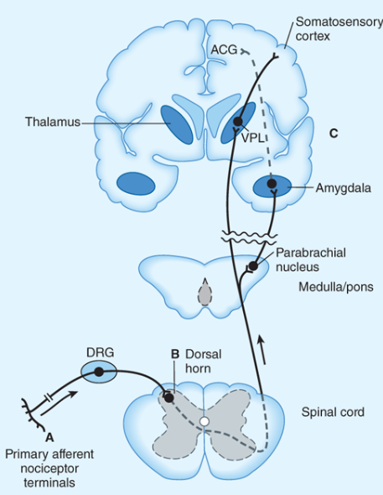
Action of opioid analgesics in the ascending pathways
A: Direct action of opioid on inflamed or damaged peripheral tissues (nociceptors).
B: Inhibition occurs in the spinal cord (nociceptive transmission).
C: Possible sites of action in the thalamus (relay pathway).

Slide 6
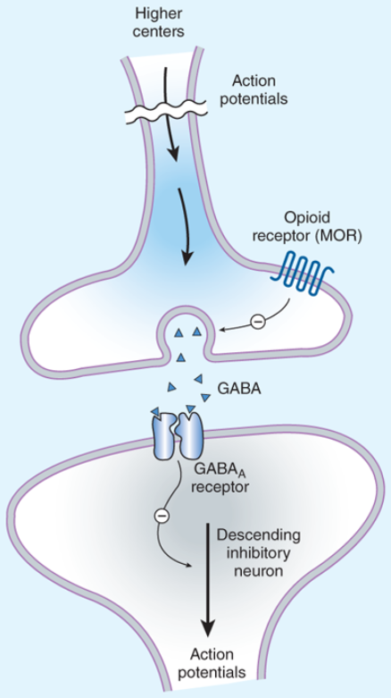
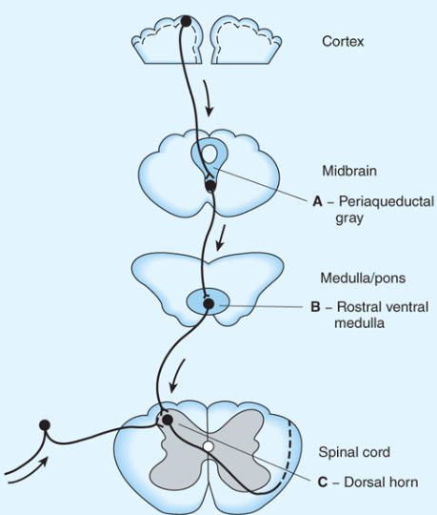
Action of opioid analgesics in the descending pathways
FIGURE 31–3
Brainstem local circuitry underlying the modulating effect of µ-opioid receptor (MOR)–mediated analgesia on descending pathways. The pain-inhibitory neuron is indirectly activated by opioids (exogenous or endogenous), which inhibit an inhibitory (GABAergic) interneuron. This results in enhanced inhibition of nociceptive processing in the dorsal horn of the spinal cord

Slide 7
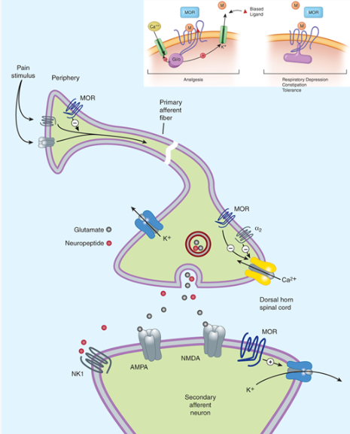
Common Opioid Receptor Signaling Pathways

Slide 8
Potential receptor mechanisms of analgesic drugs.
Action potentials reaching the dorsal horn can be attenuated at the presynaptic ending by opioids that decrease VGCC (N-type).
VGCC inhibition leads to decreased transmitter release.
Opioids also inhibit the postsynaptic neuron by enhancing K current resulting in hyperpolarization.
Inhibitory actions on Ca2+ channel at presynaptic and K channel at postsynaptic sites

Slide 9
The analgesic effect of opioids is caused by neuronal inhibition. Which of the following cellular response accounts for opioid-caused neuronal inhibition?
A. Endogenous neuropeptide release
B. Ca channel activation and cell membrane depolarization
C. K channel activation and cell membrane hyperpolarization
D. Enhancement of GABA neurotransmission

Slide 10
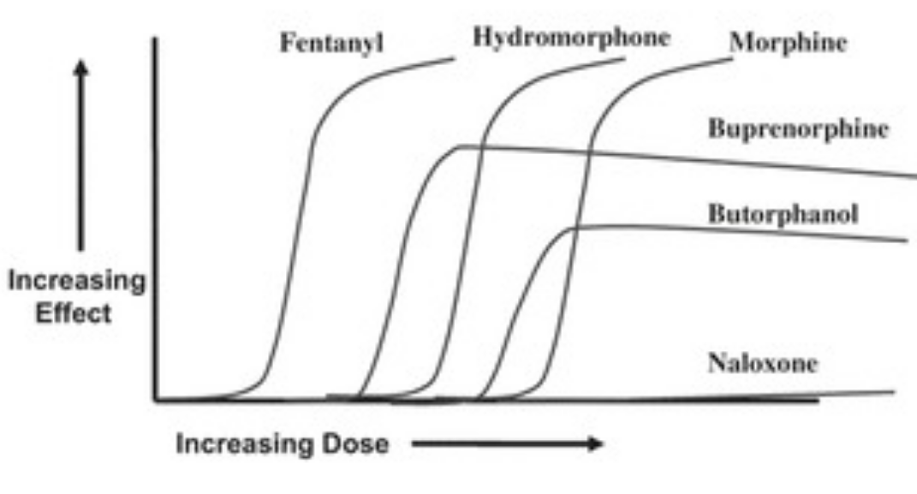
Potency and Efficacy: to determine pharmacological effects
of opioids on µ receptors (agonists, partial agonists, antagonists)
Butorphanol has significantly greater analgesia in women than in men

Slide 11
Which of the following is a full opioid agonist for MOR? [Select all that apply]
Morphine
Fentanyl
Hydromorphone
Buprenorphine
Butorphanol
Which of the following is a partial opioid agonist for MOR? [Select all that apply]
Morphine
Fentanyl
Hydromorphone
Buprenorphine
Butorphanol
Which of the following is an opioid antagonist for MOR?
Morphine
Fentanyl
Hydromorphone
Buprenorphine
Butorphanol
F. Naloxone

Slide 12
Which one of the following opioids has the highest potency?
Morphine
Fentanyl
Hydromorphone
Buprenorphine
Butorphanol
Which one of the following opioids has the highest potency?
Morphine
Hydromorphone
Buprenorphine
Butorphanol
Which one of the following opioids has the highest efficacy?
Hydromorphone
Buprenorphine
Butorphanol
Naloxone

Slide 13
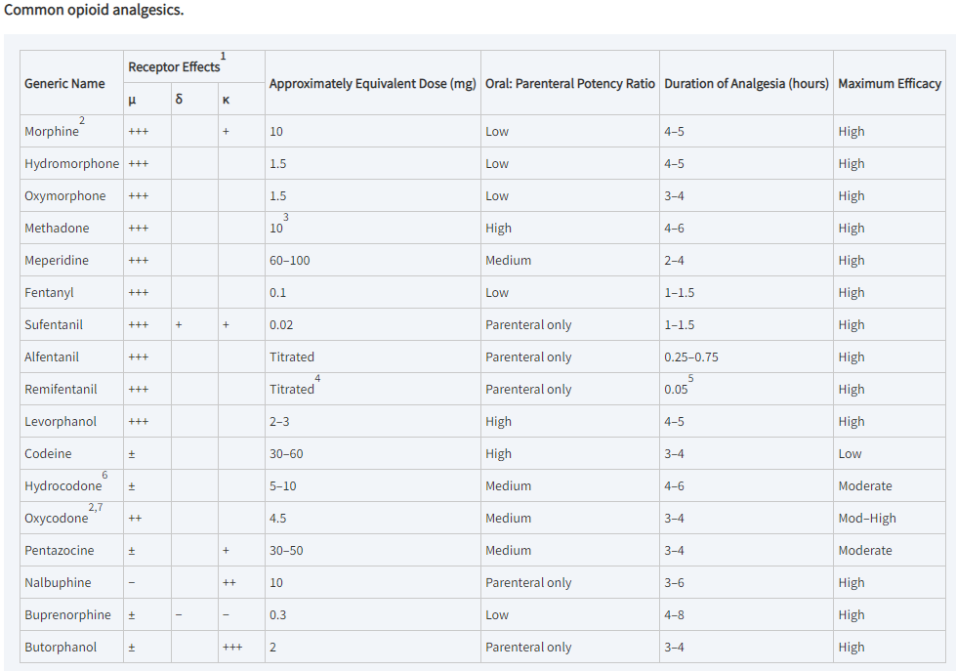
¹+++, ++, +, strong agonist; ±, partial or weak agonist; -, antagonist.
²Available in sustained-release forms, morphine (MS Contin); oxycodone (OxyContin).
³No consensus—may have higher potency.
⁴Administered as an infusion at 0.025–0.2 mcg/kg/min.
⁵Duration is dependent on a context-sensitive half-time of 3–4 minutes.
⁶Available in tablets containing acetaminophen (Norco, Vicodin, Lortab, others).
⁷Available in tablets containing acetaminophen (Percocet); aspirin (Percodan).

Slide 14
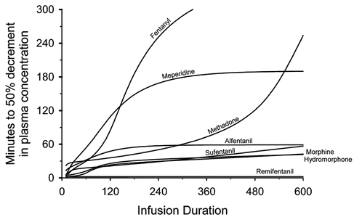
The context-sensitive half-time is the time required for blood or plasma concentrations of a drug to decrease by 50% after discontinuation of drug administration
The “context-sensitive half-time” (50% plasma decrement time) for fentanyl, alfentanil, sufentanil, remifentanil, morphine, methadone, meperidine, and hydromorphone, based on the pharmacokinetics

Slide 15
CNS Effects
Analgesia
Euphoria (intense feelings of well-being, elation, happiness, ecstasy, excitement and joy)
Sedation
Respiratory depression
Cough suppression
Miosis (constriction of the pupil)
Truncal rigidity (w/lipid soluble opioids)
Nausea/Vomiting
PNS Effects
Smooth muscle (See GI)
CV – Most have no major effects!
GI – Constipation (motility drops, increased absorption)
Renal function decrease
May prolong labor

Slide 16
Which of the following adverse effect accounts for the death by opioid overdose?
A. Respiratory depression
B. Sedation
C. Constipation
D. Euphoria
E. Hypotension
Which of the following is a peripheral effect of morphine?
A. Constipation
B. Bradycardia and hypotension
C. Biliary colic and/or biliary duct spasm
D. Urinary retention
E. All of the above

Slide 17
Pharmacological actions
1. Analgesia: acts on CNS
pain less intense
pain threshold elevated
less discomfort (more effective for dull pain)
sharp intermittent pain relieved
2. SEDATION: at therapeutic dosage; however, in extremely high doses opioids produce convulsions (e.g., meperidine)
3. EUPHORIA: more prominent in addicted individuals
4. RESPIRATORY DEPRESSION:
High dose; respiratory failure and Death
Decrease sensitivity of brain stem centers to CO₂
Pure oxygen can induce apnea during severe respiratory depression
5. NAUSEA AND VOMITING: stimulate the chemoreceptor trigger zone (CTZ) in the medulla oblongata
6. COUGH REFLEX (antitussive effect): suppress the cough reflex

Slide 18
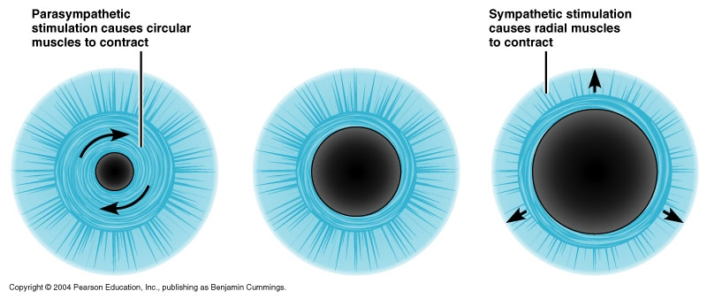
Pharmacological actions (cont’d)
7. Miosis: Act on μ and κ in oculomotor cucleus, causing pupillary constriction (constrict pupil)
Pinpoint pupils are characteristics of morphine overdose.
mydriasis
Pinpoint pupils
Dilated pupils
Codeine is a potent inhibitor of the cough reflex
Meperidine has a weak effect
Dextromethorphan has no GI effects, no respiration depression, no analgesia

Slide 19
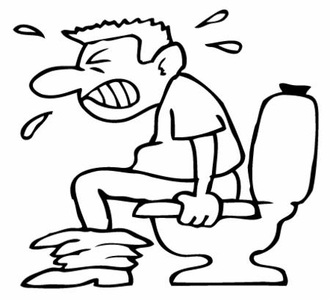
Pharmacological actions (cont’d)
GASTROINTESTINAL TRACT
Decreases GI motility: constipation
Biliary tract spasm
exacerbate biliary colic (cholelithiasis,
a gallbladder attack or gallstone attack)
CARIOVASCULAR SYSTEM
No prominent effects
Peripheral vasodilation most prominent effect due to histamine release and decreased adrenergic tone
Very high doses may produce bradycardia
Orthostatic hypotension
All of the following statements about opioid analgesics are correct EXCEPT: A. They have no significant direct effects on the heart
B. They do not cause respiratory depression even overdosed C. They reduce urine production
D. They increase intestinal peristalsis

Slide 20
Pharmacological actions (cont’d)
URINARY TRACT
Increase tone of urinary sphincter; urinary retention
Decrease urine production (increased ADH secretion)
UTERUS: may be prolonged
BRONCHIAL SMOOTH MUSCLE
Therapeutic doses have no effect
High doses produce constriction (can aggravate asthma)

Slide 21
Toxicicity
ACUTE TOXICITY
Dose dependent
Morphine (oral)
10 mg: therapy
10-30 mg: adverse effects
30-120 mg: severe toxicity (respiratory depression)
> 120 mg: lethal
Symptoms
Profound coma; Depressed respiration (2 to 4/min); Cyanosis; Pinpoint pupils;
Low blood pressure; Low body temperature;
Decreased urine formation;
Constipation
Flaccid muscles
Treatment
Ventilation (do not give 100% oxygen because it can induce apnea)
Naloxone (Narcan) will reverse toxic signs
Naltrexone has a longer duration of action

Slide 22
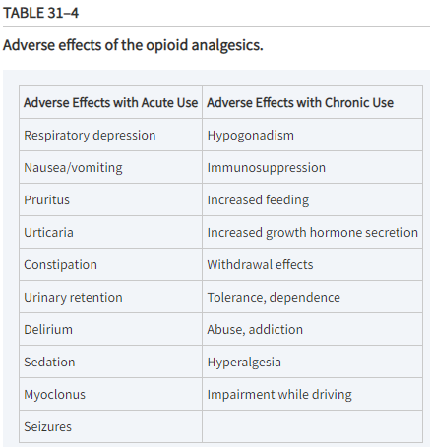

Slide 23
Tolerance
With continued use, progressively more and more opioid is necessary to produce the same effect
Tolerance develops in
Analgesic, euphoric, sedative actions, Emetic
Biliary and urethral sphincter muscles
Tolerance does not develop in
Miosis
Constipation
Symptoms of opioid withdrawal:
Diaphoresis (excessive sweating), Lacrimation (tears), Coryza (acute rhinitis), Tachycardia, Abdominal cramps, Nausea, Vomiting
Physical Dependence: A state of adaptation that is manifested by a drug class specific withdrawal syndrome that can be produced by abrupt cessation, rapid dose reduction, decreasing blood level of the drug, and/or administration of an antagonist.

Slide 24
Which of following response tolerance may develop after repeated use of an opioid?
Analgesic
Euphoric
Sedative actions
Emetic
Biliary and urethral sphincter muscle spasm
All of the above
Which of following response tolerance may not develop after repeated use of an opioid?
[Select all that apply]
Analgesic
Miosis
Constipation
Euphoric
Emesis

Slide 25
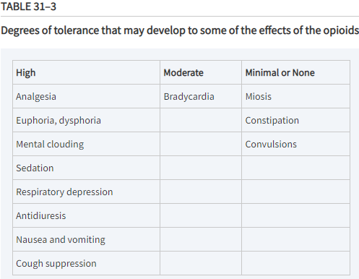

Slide 26
Opioid Drug Interactions

Slide 27
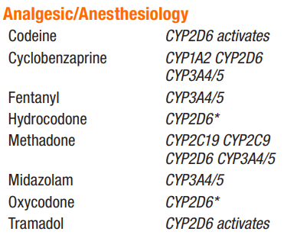
First-pass metabolism: morphine (high) vs codeine or oxycodone (low)
Mucosa and transdermal delivery
Opioids distribution and redistribution: relate to blood flow
Fentanyl redistribution: fat and muscle redistribution
CYP3A4 in the mucosa of the small intestine contributes to the
first-pass metabolism of fentanyl
4. Codeine undergo metabolism by CYP2D6 producing metabolites of greater potency
5. Genetic polymorphism of CYP2D6 has been documented and linked to the variation
in analgesic and adverse responses (codeine caused respiratory depression death
in pediatric patients: caution to use codeine in kids)
6. The most important hepatic pathway for metabolism of opioids is CYP2B6

Slide 28
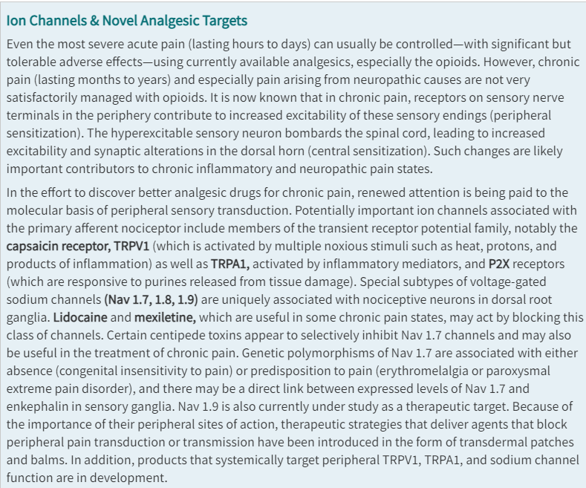

Slide 29
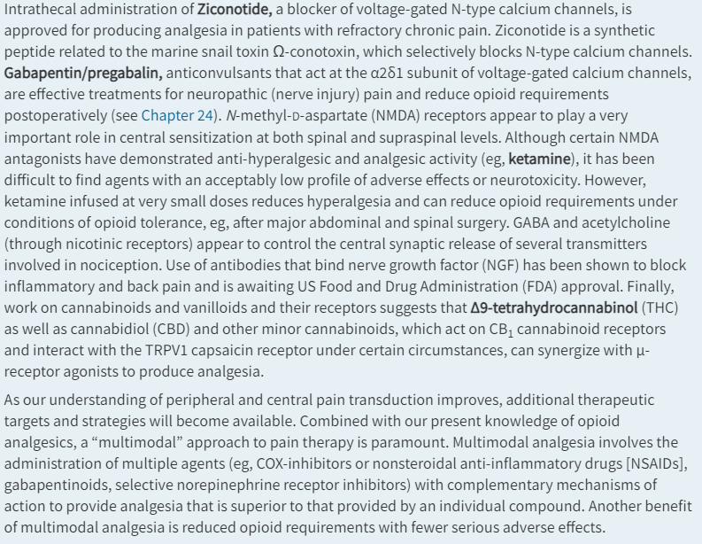

Slide 30
Which of following may be a target for management of chronic pain?
Transient receptor potential family (TRPV1, TRPA1)
P2X
Na channels (Nav1.7, 1.8, 1.9, Lidocaine, mexiletine, centipede toxin)
N-type Ca channels (Ziconotide)
Alpha2delta1 subunit of Ca channel (gabapentin/pregabelin)
NMDA receptors (ketamine)
CB1 receptors (cannabinoids, CBD/THC)
All of the above

